Slide 1

Dataset: IPL All Time Best Batsman
Batch : DA81S8
Mentor : Ms. Jaya Pandey
Student : Vishwavijay Tomar

Slide 2

Introduction
Dive into the world of cricket brilliance with the "Indian Premier League (IPL) All-Time Best Batsmen" dataset. Covering a decade of IPL history, this dataset showcases the top-notch batting performances that have illuminated the league. From aggressive power-hitters to masterful accumulators, explore the records, milestones, and match-defining innings that have shaped the IPL's legacy. Ideal for cricket enthusiasts, analysts, and followers of the IPL, this dataset offers a captivating glimpse into the finest moments of T20 cricket.
As a dedicated data scientist in our esteemed company, you've been assigned a captivating project that involves delving into the dataset of all-time best batsmen in the Indian Premier League (IPL). Your objective is to extract meaningful insights and uncover patterns that can illuminate the factors contributing to their outstanding performances.

Slide 3

Data Dictionary
POS (Position): The player's batting position in the lineup.
Player: The name of the cricket player.
Team: The IPL team the player is associated with.
Mat (Matches): The total number of matches played by the player.
Inns (Innings): The total number of innings played by the player.
NO (Not Outs): The number of times the player remained not out.
Runs: The total runs scored by the player.
HS (Highest Score): The highest individual score achieved by the player in a single inning.
Avg (Average): The batting average of the player.
BF (Balls Faced): The total number of balls faced by the player.
SR (Strike Rate): The strike rate of the player, calculated as (Runs/Balls Faced) * 100.
100 (Centuries): The number of centuries scored by the player.
50 (Half-Centuries): The number of half-centuries scored by the player.
4s (Fours): The total number of fours hit by the player.
6s (Sixes): The total number of sixes hit by the player.

Slide 4
Business Requirements
Objective : Your primary goal is to uncover meaningful patterns, trends, and statistics from the dataset to help stakeholders, including team management and cricket enthusiasts, gain a deeper understanding of the performance of the best batsmen in IPL history.
What are the top run-scorers
Who are the players with the highest batting averages
Who are the players with the highest strike rates
Who are the players with the most 6s
Find average and Strike Rate Analysis
Get the players with the highest number of centuries
Sort players with the highest number of fifties
Find the players with the best batting strike rate in powerplays
Get the players with the highest boundaries percentage
Find out the players who scored more than 10 centuries

Slide 5

1. Python:
Used Python for data analysis and manipulation.
Performed data cleaning, exploration, and basic statistical analysis.
Data Loading: Utilized Python to load the “IPL best batsmen” dataset.
Data Exploration: Explored the dataset to understand its structure and contents.
Data Cleaning: Employed Pandas library to clean and preprocess the data then checked the null values if their or not .
SQL Database Creation: Created a MySQL database named “Preplacement_project" using Python.
SQL Analysis: Executed SQL queries for relational database analysis.
2. SQL:
Created a MySQL database named "preplacement_project" using Python.
Executed SQL queries to analyze data at a relational database level.
Extracted information such as the the top run-scorers, Strike Rate Analysis, etc.
3. Tableau:
Visualized the dataset for more intuitive insights.
Created interactive dashboards and visualizations.
Summary of Steps:
Data Collection: Downloaded data from Kaggle.
Python Analysis: Used Python and Pandas for initial cleaning and creating database in SQL .
MySQL Database Creation: Established a MySQL database named "preplacement_project" using Python.
SQL Analysis: Executed SQL queries for exploratory database analysis.
Tableau Integration:created visualizations, and designed dashboards.

Slide 6

Business Requirements | Insights | Tools used
What are the top run-scorers | Top 5 run-scorers are Virat Kohli(7263) with the maximum score followed by other players like Shikhar Dhawan(6617), David Warner(6397), Rohit Sharma(6211), Suresh Raina(5528). | SQL: EDA
Who are the players with the highest strike rates | Players with the highest strike rates (Minimum 1000 runs) are Andre Russell (174), Sunil Naraine(159.69), Glenn Maxwell(157.62), Nicholas Pooran(156.79), Virendra Sehwag(155.44). | SQL: EDA
Who are the players with the most 6s | Players with the most 6s are Chris Gayle(357), Rohit Sharma(257), AB De Villiers(251), MS Dhoni(239),Virat Kohli(234). | SQL: EDA
Find out the players who scored more than 10 centuries | Top 5 players who scored more than 10 centuries are Virat Kohli, Shikhar Dhawan, David Warner, Rohit Sharma, Suresh Raina these players have made 100 centuries. | SQL: EDA

Slide 7

Business Requirements | Insights | Tools used
Find average and Strike Rate Analysis | Top 5 Average and Strike Rate Analysis of players are : Devon Convoy (Avg:48.63 SR:141.28) KL Rahul (Avg:46.73 SR:134.42) Sai Sudarshan (Avg:46.09 SR:137.03) Hashim Amla (Avg:44.38 SR:141.77) David Warner (Avg:41.54 SR:139.92) | SQL: EDA
Find the players with the best batting strike rate in powerplays | None of the players have the best batting strike rate in powerplays Runs > 500 in powerplays) | SQL: EDA
Get the players with the highest number of centuries | Players with the highest number of centuries Virat Kohli, Shikhar Dhawan, David Warner, Rohit Sharma, Suresh Raina. | SQL: EDA
Sort players with the highest number of fifties | Players with the highest number of fifties are Virat Kohli with the highest no. of 50s then comes Shikhar Dhawan, David Warner, Rohit Sharma, Suresh Raina. | SQL: EDA

Slide 8

Business Requirements | Insights | Tools used
Get the players with the highest boundaries percentage | Players with the highest boundary percentage (4s and 6s per run) are Sunil Naraine with 17.02%, Yashasvi Jaiswal with 16.38%, Virendra Sehwag 16.13%, Sanath Jayasuriya 16.06%, Paul Valthaty 16.04% | SQL: EDA
Who are the players with the highest batting averages | Top 5 Players with the highest batting averages are as follows Virat Kohli, Shikhar Dhawan, David Warner, Rohit Sharma, Suresh Raina all with 1 century count | SQL: EDA
Top Performing Players |  | Tableau: Visualization
Fan Engagement |  | Tableau: Visualization
Player strengths and weaknesses |  | Tableau: Visualization
Most experienced batsman |  | Tableau: Visualization
Most 6s |  | Tableau: Visualization
-------**-------

Slide 9

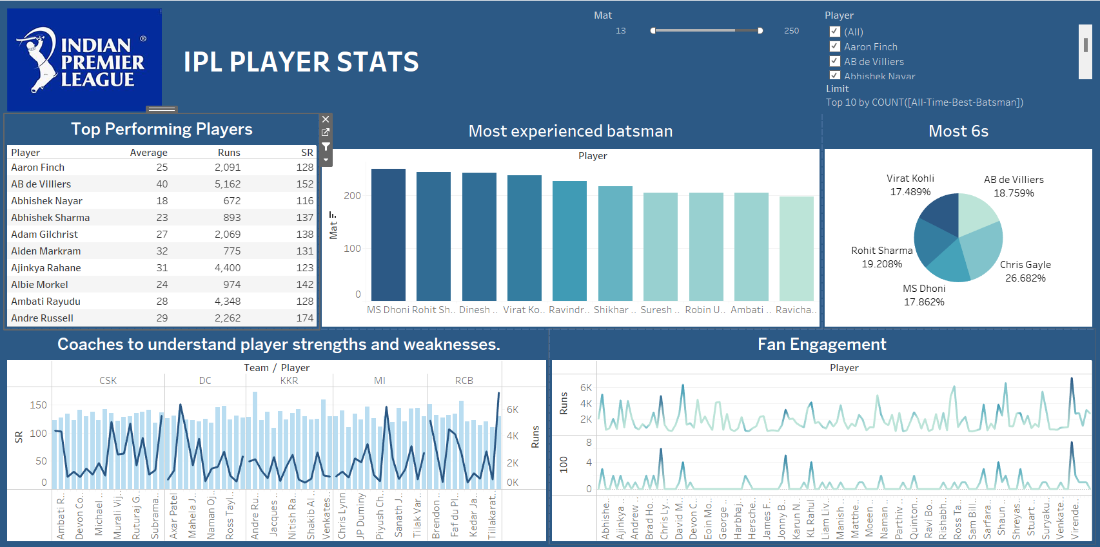
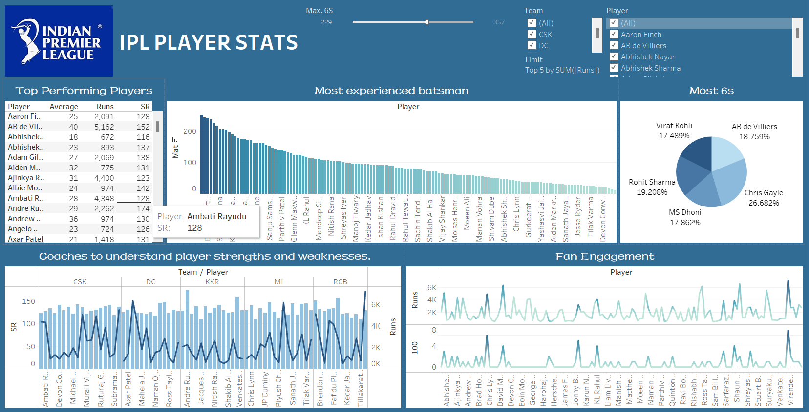
DASHBOARD OF ANALYSIS

Slide 10

Conclusion:
Batting Performance: The analysis primarily focuses on batting performance, emphasizing runs, average, and strike rate.
Consistency and Big Scores: The inclusion of centuries (100) and fifties (50) indicates the importance of consistent and impactful performances.
Boundary-Hitting Skills: Columns like 4s and 6s help assess a player's ability to hit boundaries.
Powerplay Performance: The analysis includes a query focused on powerplay performance, considering the number of runs scored during the initial overs.
Focus Columns:
Player: Essential for player identification.
Mat (Matches): Provides information about the number of matches played.
Runs: Central to batting performance analysis.
HS (Highest Score): Indicates a player's highest individual score.
Average: Critical for evaluating a player's batting consistency.
SR (Strike Rate): Crucial for understanding the scoring efficiency of a player.
100 (Centuries): Highlights a player's ability to score centuries.
50 (Fifties): Reflects a player's consistent ability to reach half-centuries.
4s (Fours) and 6s (Sixes): Important for analyzing boundary-hitting skills.
BF (Balls Faced): Aids in determining a player's involvement in the game.
Unnecessary Columns:
Run Outs: Excluded as it's not directly related to individual batting performance.
Wkts (Wickets): Not relevant for batsmen; this is more related to bowlers.
BBI (Best Bowling Innings): Irrelevant for batsmen; mainly for bowlers.
Econ (Economy Rate): Pertains to bowlers, not required for batsmen analysis.

